Slide 1
Organizations and
Organization Theory
Organization Theory and Design
Eleventh Edition
Richard L. Daft
©2013 Cengage Learning. All Rights Reserved. May not be scanned, copied or duplicated, or posted to a publicly accessible website, in whole or in part.

Slide 2
Organization Theory in Action
Current Challenges
  Globalization
  Intense Competition
  Ethics and Social Responsibility
  Speed of Responsiveness
  The Digital Workplace
  Diversity
Organization theory helps us explain what happened in the past, as well as what may happen in the future, so that we can manage organizations more effectively
©2013 Cengage Learning. All Rights Reserved. May not be scanned, copied or duplicated, or posted to a publicly accessible website, in whole or in part.

Slide 3
What is an Organization?
Social entities that are goal-directed
Designed as deliberately structured and coordinated activity systems
Linked to the external environment
Includes large multinational corporations, family owned businesses as well as nonprofits
©2013 Cengage Learning. All Rights Reserved. May not be scanned, copied or duplicated, or posted to a publicly accessible website, in whole or in part.

Slide 4
Importance of Organizations
Organizations are a means to an end
The corporation has played a significant role in the last 100 years
Produce goods and services efficiently
Facilitate innovation
Adapt to and influence a changing environment
Create value for owners, customers, and employees
Accommodate ongoing challenges of diversity, ethics, and the motivation and coordination of employees
©2013 Cengage Learning. All Rights Reserved. May not be scanned, copied or duplicated, or posted to a publicly accessible website, in whole or in part.

Slide 5
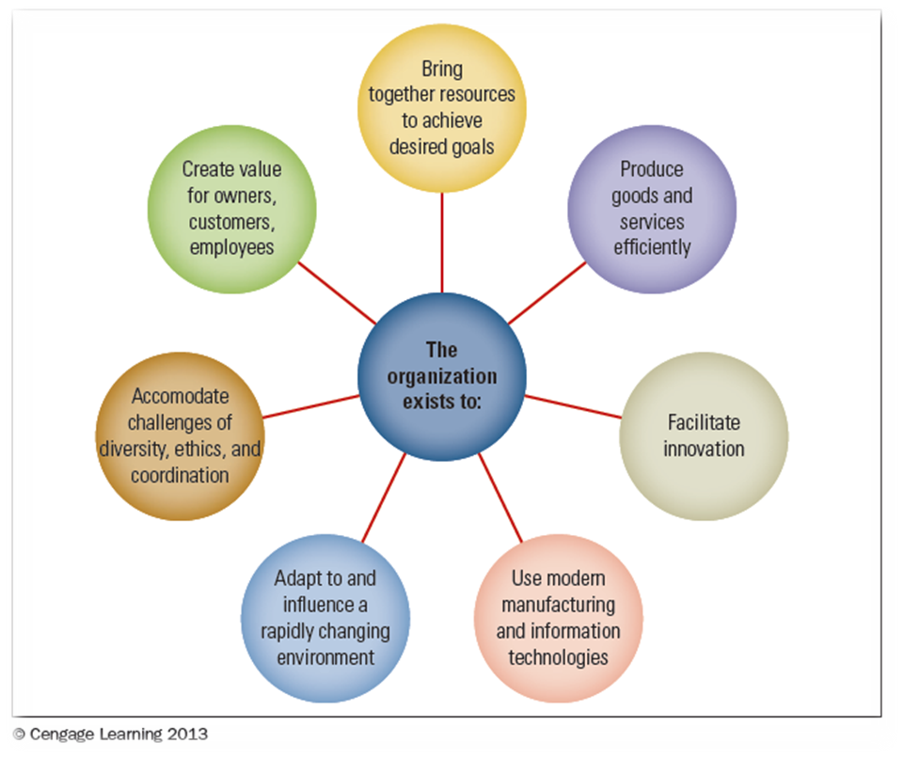
The Importance of Organizations
©2013 Cengage Learning. All Rights Reserved. May not be scanned, copied or duplicated, or posted to a publicly accessible website, in whole or in part.

Slide 6
Dimensions of
Organization Design
Structural Dimensions
  Formalization
  Specialization
  Hierarchy of Authority
  Centralization
  Professionalism
  Personnel Ratios
Contingency Factors
  Size
  Organizational technology
  Environment
  Goals and strategy
  Culture
©2013 Cengage Learning. All Rights Reserved. May not be scanned, copied or duplicated, or posted to a publicly accessible website, in whole or in part.

Slide 7
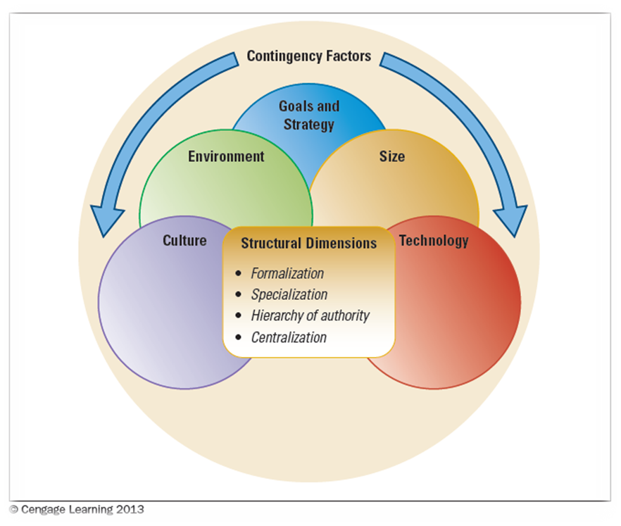
Interacting Structural Dimensions of Design and Contingency Factors
©2013 Cengage Learning. All Rights Reserved. May not be scanned, copied or duplicated, or posted to a publicly accessible website, in whole or in part.

Slide 8
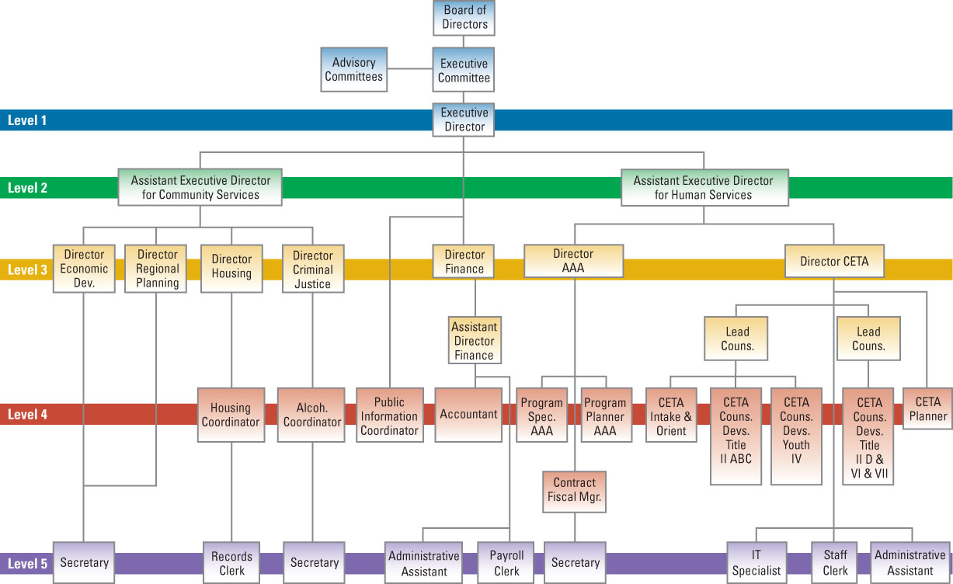
Organization Chart
©2013 Cengage Learning. All Rights Reserved. May not be scanned, copied or duplicated, or posted to a publicly accessible website, in whole or in part.

Slide 9
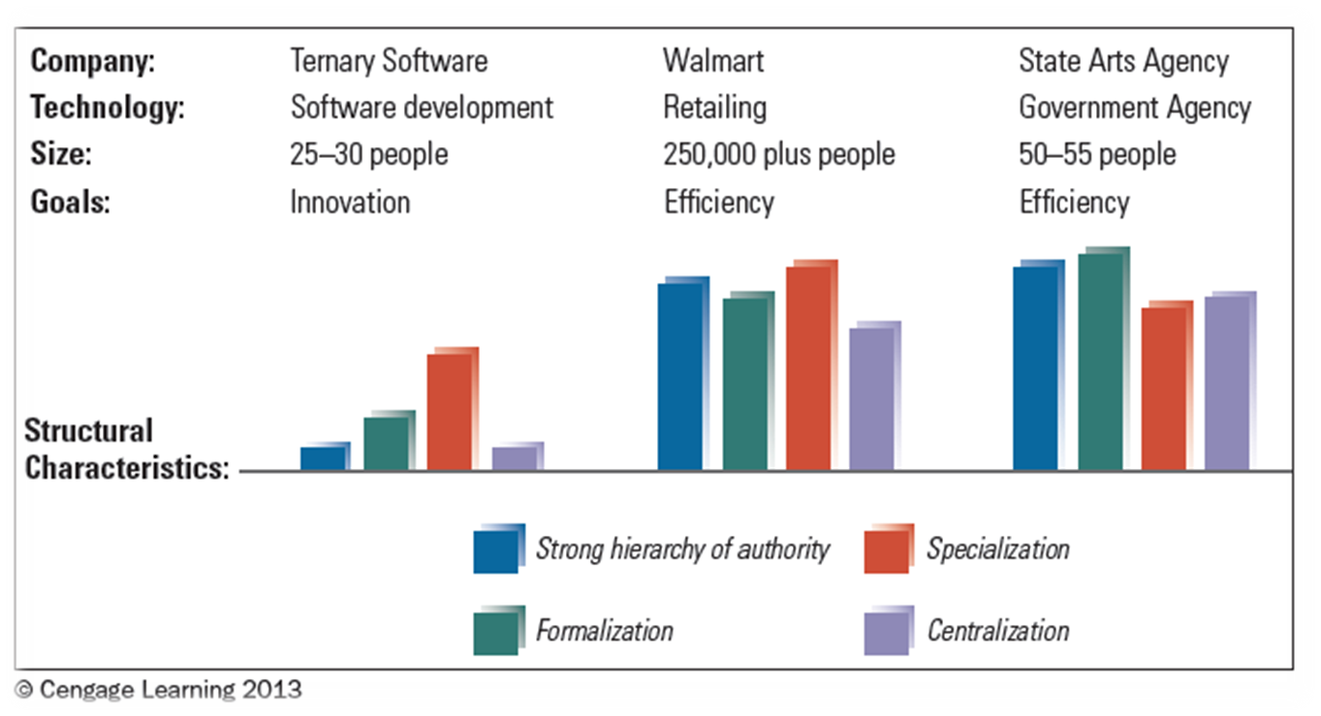
Characteristics of Three Organizations
©2013 Cengage Learning. All Rights Reserved. May not be scanned, copied or duplicated, or posted to a publicly accessible website, in whole or in part.

Slide 10
Performance and
Effectiveness Outcomes
Efficiency – amount of resources used to achieve the organization’s goals
Effectiveness – the degree to which an organization achieves its goals
Stakeholder Approach – balancing the needs of groups in and outside of the organization that has a stake in the organization’s performance
©2013 Cengage Learning. All Rights Reserved. May not be scanned, copied or duplicated, or posted to a publicly accessible website, in whole or in part.

Slide 11
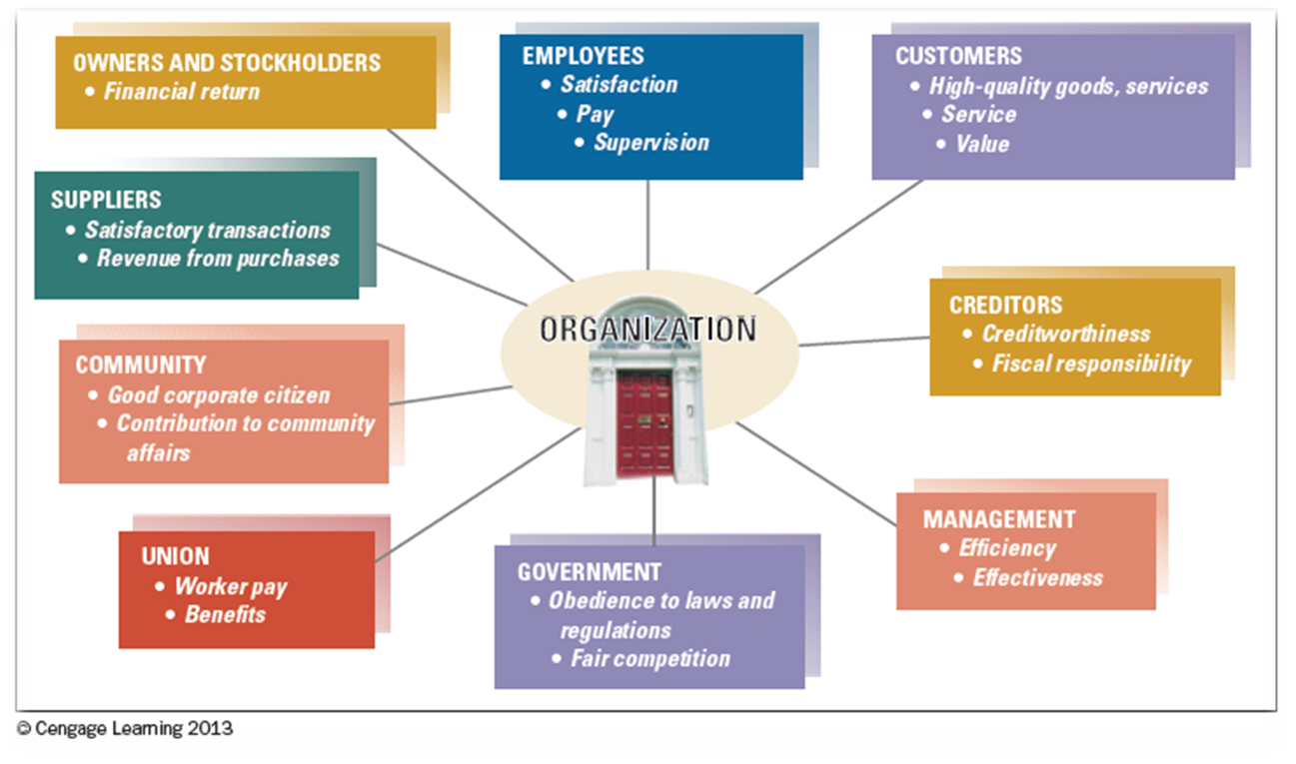
Major Stakeholder Groups and What They Expect
©2013 Cengage Learning. All Rights Reserved. May not be scanned, copied or duplicated, or posted to a publicly accessible website, in whole or in part.

Slide 12

The Evolution of Organization Theory and Design
Historical perspectives provide insight into how organization design and management practices have varied over time in response to changes in society.
©2013 Cengage Learning. All Rights Reserved. May not be scanned, copied or duplicated, or posted to a publicly accessible website, in whole or in part.

Slide 13
Historical Perspectives
Efficiency is Everything
  Scientific Management: Pioneered by Frederick Winslow Taylor
How to Get Organized
  Administrative Principles
    Contributed to Bureaucratic Organizations
What about People?
  Hawthorne Studies
Can Bureaucracies Be Flexible?
  Flexible and lean; focused on service, quality, and engaged employees (1908s)
It All Depends: Key Contingencies
  Contingency: there is no “one best way”
©2013 Cengage Learning. All Rights Reserved. May not be scanned, copied or duplicated, or posted to a publicly accessible website, in whole or in part.

Slide 14
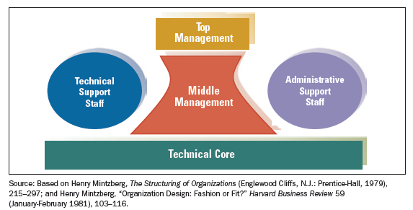
Mitzberg’s Organizational Types
Mintzberg proposed that the five parts could fit together in any type of organization
In real-life organizations, the five parts are interrelated and often serve more than one function
©2013 Cengage Learning. All Rights Reserved. May not be scanned, copied or duplicated, or posted to a publicly accessible website, in whole or in part.

Slide 15
Organic vs. Mechanistic
Mechanistic – characterized by machine-like standard rules and procedures with clear authority
Organic – design of organization is looser, free-flowing, and adaptive
    Depends upon:
      Structure
      Tasks/Roles
      System Formality
      Communication
      Hierarchy versus Collaboration
©2013 Cengage Learning. All Rights Reserved. May not be scanned, copied or duplicated, or posted to a publicly accessible website, in whole or in part.

Slide 16
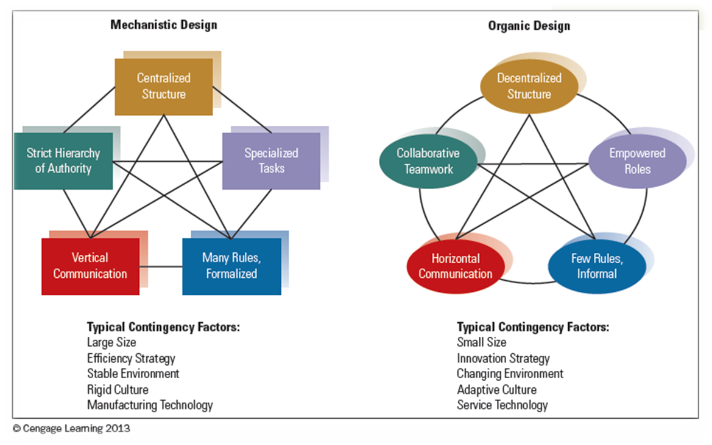
Organic and Mechanistic Designs
©2013 Cengage Learning. All Rights Reserved. May not be scanned, copied or duplicated, or posted to a publicly accessible website, in whole or in part.

Slide 17
Contemporary Ideas
Today’s organizations are still imprinted with hierarchical, formalized mechanistic approach
Open Systems are adaptive and interact with the environment
Chaos theory states that relationships in complex systems are nonlinear
  Chaos operates with some predictability which is the challenge of today’s managers
©2013 Cengage Learning. All Rights Reserved. May not be scanned, copied or duplicated, or posted to a publicly accessible website, in whole or in part.

Slide 18
Framework for the Book
Examine specific characteristics of organizations
Examine the nature of and relationships among groups and departments
Organizational behavior is the micro approach
Organization theory is the macro examination
Organization theory is concerned with the big picture of the organization and its major departments
©2013 Cengage Learning. All Rights Reserved. May not be scanned, copied or duplicated, or posted to a publicly accessible website, in whole or in part.

